Slide 1
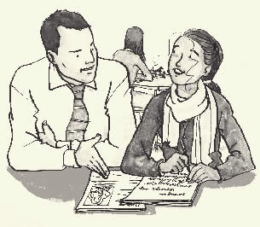
Assessment For Learning Tools
Made by Mike Gershon – mikegershon@hotmail.com
AfL is successful when embedded in teaching and learning.
This toolkit aims to help by presenting different facets, activities and tools for teachers to use in order to achieve this.
I hope you find it useful!
Sources
http://www.aaia.org.uk/pdf/Publications/AAIA%20Pupils%20Learning%20from%20Teachers'%20Responses.pdf
http://www.aaia.org.uk/pdf/Publications/AAIAformat4.pdf
http://www.aaia.org.uk/pdf/asst_learning_practice.pdf
http://community.tes.co.uk/forums/t/300200.aspx
http://www.schoolhistory.co.uk/forum/lofiversion/index.php/t7669.html
www.harford.edu/irc/assessment/FormativeAssessmentActivities.doc
Paul Black et al, Assessment for Learning, (Open University Press, Maidenhead, 2003)
Paul Black et al, “Working inside the black box”, (nferNelson, London, 2002)
Paul Black and Dylan William, Inside the Black Box, (nferNelson, London, 1998)
Assessment Reform Group, Testing, Motivation and Learning, (The Assessment Reform Group, Cambridge, 2002)
Assessment Reform Group, Assessment for Learning, (The Assessment Reform Group, Cambridge, 1999)
My head
Other people’s heads

Slide 2
AfL Tools
Students write Questions Students ask Questions Comment-only marking Mid-unit assessment ‘Might’
Wait-time Open vs closed Exemplar Work Student Marking Making aims clear
Lesson Target Setting Teacher Review Student Review Traffic Lights 2 stars and a wish
Self-assessment Targets One-Sentence Summary Articulate then Answer Scene-Setting Tell your neighbour
Idea Thoughts Bouncing Wait and recap Incorrect Discussion Muddiest Point
Devising Questions Learning Journal Redrafting Key features Invert the Question
Improvement Guidance Comment Follow-up Group feedback Peer Marking Thumbs
Teach Collaboration Traffic-Light Revision Generate and Answer Student Mark-Scheme Group Answers
X and Y All you know Corrections Laminated Criteria Conveying Progress
Think through Talking Discuss Words Communication Thoughtful Dialogue Feedback Sandwich
What is good? Self-evaluation What is a ‘good’ question? Graphic Organisers KWL
Talk Partners Post-It Response Partners Hands Down Question Stems
Regulating Learning A B C D Why is it best? Show and Tell Active Students
Long and Short Term Minute Paper Enquiry Question Smiley Faces Squares

Slide 3
Students write Questions
Back to AFL Tools
For example –
About what they would like to know on a new topic
To ask the teacher or other students in order to assess their learning
To demonstrate their learning/misconceptions/areas they would like to further explore
The classroom could have a question box
where students drop questions at the
end of a lesson.
Or, a plenary could involve students writing
questions that the class then work on
together, or forms the basis of the next lesson.

Slide 4
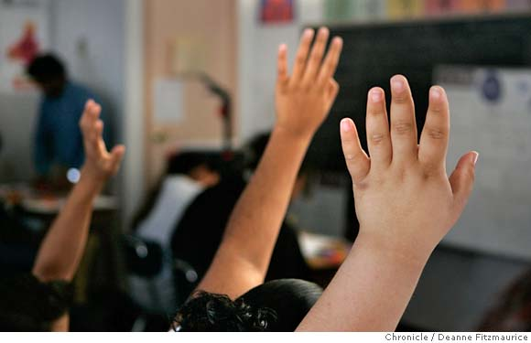
Students ask Questions
Back to AFL Tools
Create opportunities for students to
ask questions. This could be of their
peers, of the teacher or as a means
to develop discussion.
A ‘question box’ for written questions
offers a different means of
communication for students
Allow time for students to ask
questions about pieces of work. This
helps open up assessment and
eliminate ambiguity

Slide 5
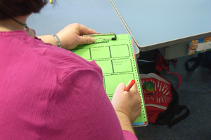
Comment-only marking
Back to AFL Tools
Comment-only marking provides students
with a focus for progression instead of a
reward or punishment for their ego (as a
grade does).
Comments could be made in books, in a
table at the front of books, in a learning
diary or journal. The latter are helpful for
teacher and student to track the
progression of comments and see
improvement.
Comments should make it clear how the
student can improve.
Plan activities and work with feedback in
mind – let the design assist the process.

Slide 6
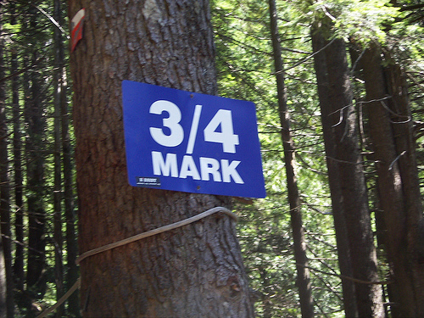
Mid-unit assessment
Back to AFL Tools
Having an assessment at the end of a
unit may not provide time for you to
go over areas students have
struggled with, or in which there are
general misconceptions.
Timing assessment during a unit (i.e.
lesson 5 of 7) allows time to review,
reflect and revisit.
It also gives the teacher an
opportunity to focus explicitly on
areas of weak understanding
supported by evidence.

Slide 7
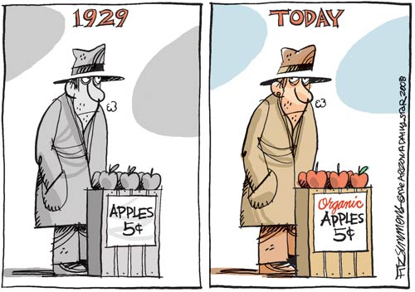
‘Might’
Back to AFL Tools
When questioning, insert the word
‘might’ to give students greater
opportunity to think and explore
possible answers.
e.g.
What is meaning of democracy?
What might the meaning of
democracy be?
The first infers a single answer known
by the teacher whereas the second is
inherently more open.
What might the Great Depression look like today?

Slide 8
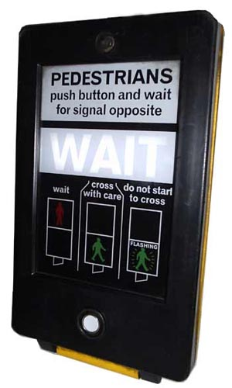
Wait-time
Back to AFL Tools
Wait time allows students time to think
and therefore to produce answers. Also,
not everyone in the class thinks at the
same speed or in the same way – waiting
allows students to build their thoughts
and explore what has been asked.
2 types of wait time –
Teacher speaks and then waits before taking student responses.
Student response ends and then teacher waits before responding. This gives the student space to elaborate or continue – or for another student to respond.

Slide 9
Open vs closed
Back to AFL Tools
Closed questions can be useful
however are not great at facilitating
the use of abstract thinking skills,
encouraging talking or eliciting much
understanding. Open questions are
more likely to do this and thus
improve learning.
e.g.
Did you go out last night?
What did you after school yesterday?

Slide 10
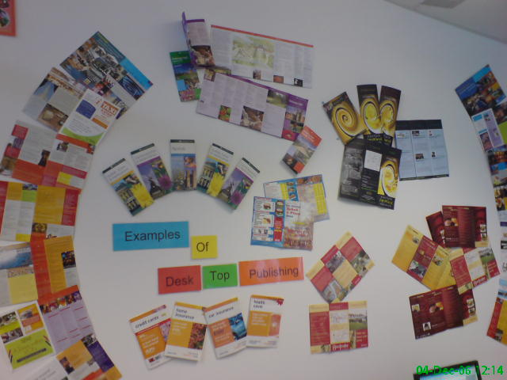
Exemplar Work
Back to AFL Tools
When setting students a piece of
work, show them examples that make
it clear what it is they are being asked
to do – and what they need to do in
order to meet the assessment criteria.
Students could mark exemplar work
using the assessment criteria. This
will help model what is being asked
for and how it relates to the process
of assessment.

Slide 11
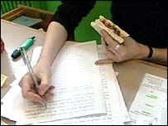
Student Marking
Back to AFL Tools
By taking part in the process of
assessment, students gain a deeper
understanding of topics, the process
of assessment and what they are
doing in their own work. This helps to
make them more aware of ‘what
learning is’ and thus see their own
learning in this way.
Students could self- or peer- mark
homework or assessments.
This could be done in pairs or
individually with a student-made or
‘official’ mark-scheme.

Slide 12
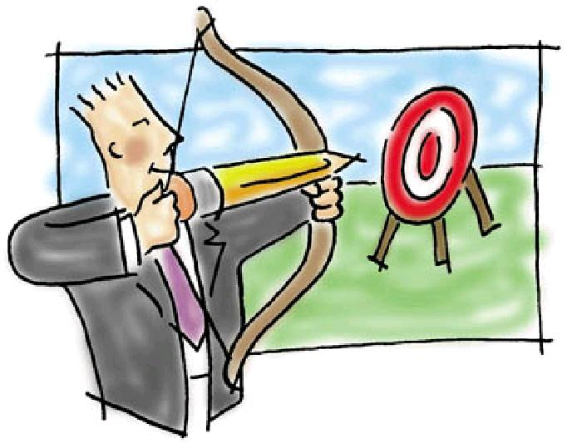
Making aims clear
Back to AFL Tools
Put lesson objectives on the board at the beginning of the lesson.
Talk to students about why they are studying what they are studying.
Contextualise short-term aims in long-term aims (e.g. analysing Shakespeare will contribute to a wider knowledge of the cultural canon and stronger analytical skills among other long term aims)
Check with students that they are clear about the aims of the lesson/unit/subject
Produce aims in conjunction with students

Slide 13
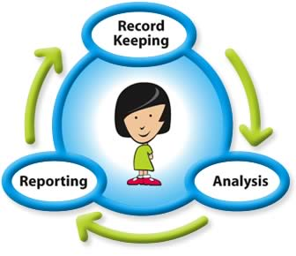
Lesson Target Setting
Back to AFL Tools
Make the lesson more purposeful for
students by setting targets at the
beginning about what you and the
class are going to do.
These can be referred to through the
lesson and/or revisited in the plenary.
Students could have to show how
they have met targets in the plenary
and/or set targets for next lesson.

Slide 14
Teacher Review
Back to AFL Tools
The teacher leads the review of the
lesson or unit using questioning to
elicit understanding from students.
Focus could also fall upon the
effectiveness of the lesson at
facilitating learning – i.e. can students
think of ways that it could be altered
to improve their learning?
The teacher could model review by
evaluating the lesson in relation to
their own objectives.

Slide 15
Student Review
Back to AFL Tools
Students review their own learning
either in groups or individually. This
could be done as a plenary, a
mini-plenary or as an activity to help
planning for future revision or the
remainder of the unit.

Slide 16
Traffic Lights
Back to AFL Tools
Use traffic lights as a visual means of
showing understanding.
e.g.
Students have red, amber and green cards which they show on their desks or in the air. (red = don’t understand, green = totally get it etc.)
Students self-assess using traffic lights. The teacher could then record these visually in their mark book.
Peer assess presentations etc. with traffic lights

Slide 17
Self-assessment Targets
Back to AFL Tools
Students give themselves targets
based on their self-assessment.
These learning goals could be
recorded somewhere and revisited
(i.e. inside cover of workbook)
They could be compared to teacher
targets and the two brought to
consensus if different.

Slide 18
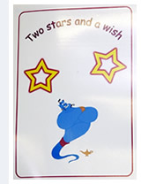
2 stars and a wish
Back to AFL Tools
For peer assessment, ask students to
give two stars and a wish.
Two stars = 2 things that are good
about the piece of work
A wish = something they can improve
to make it even better

Slide 19
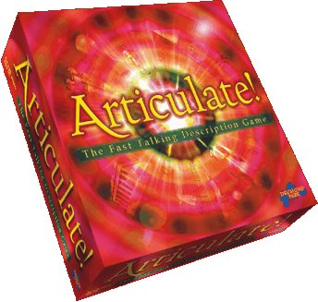
Articulate then Answer
Back to AFL Tools
Give students the opportunity to
articulate their thinking before
answering –
30 seconds silent thinking before any answers
Brainstorm in pairs first for 2-3 minutes
Write some thoughts down before answering
Discuss with your neighbour first

Slide 20
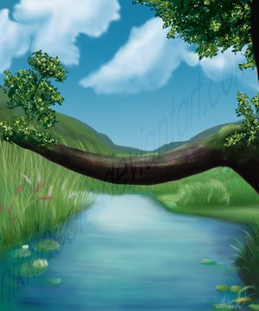
Scene-Setting
Back to AFL Tools
Set the scene for the lesson by using
a big, open question or problem-
solving task that requires abstract
thinking skills. Anticipate responses
and follow-up so as to work these
through.
E.g. A lesson on the Vietnam War
could begin with the question –
Do Americans think they fight wars, or
win them?

Slide 21
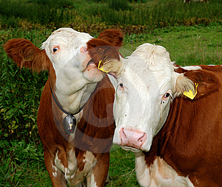
Tell your neighbour
Back to AFL Tools
Students ‘tell their neighbour’ as a
means of articulating their thoughts.
Ask a question, give thinking time
and then ask students to tell their
neighbour their thoughts.
Tell students what the new topic is and then ask them to tell their neighbour everything they know about it.

Slide 22
Idea Thoughts
Back to AFL Tools
When you have received an answer
to a question, open up the thinking
behind it by asking what others think
about the idea.
e.g. “What do others think about _________’s idea?”

Slide 23
Bouncing
Back to AFL Tools
Bounce answers around the room to
build on understanding and have
students develop stronger reasoning
out of misconceptions.
E.g.
“Jimmy, what do you think of
Sandra’s answer?”
“Sandra, how could you develop
Carl’s answer to include more detail?”
“Carl, how might you combine all
we’ve heard into a single answer?”

Slide 24
Wait and recap
Back to AFL Tools
Wait for students to draw out most of
the key words you are asking for and
then reframe the question – asking for
a synthesis which recaps the whole
discussion by joining all these words
into a single coherent answer,
paragraph etc.

Slide 25
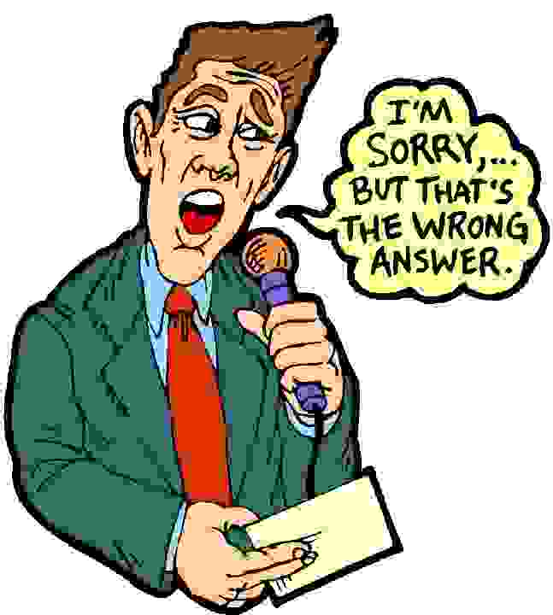
Incorrect Discussion
Back to AFL Tools
Use incorrect answers as a
discussion point.
Rather then dismissing something
because it is wrong, or saying ‘that’s
interesting’ etc. Use the
misconception in reasoning to draw
the process out into the open.
This leads to improving on
misconceived reasoning and an
atmosphere in which it is OK to be
Wrong.
I’m glad that’s the wrong answer… let’s discuss it

Slide 26
Devising Questions
Back to AFL Tools
Devise questions that –
Challenge common misconceptions
Create conflict that requires discussion
Explore ambiguity and encourage discussion and clarification

Slide 27
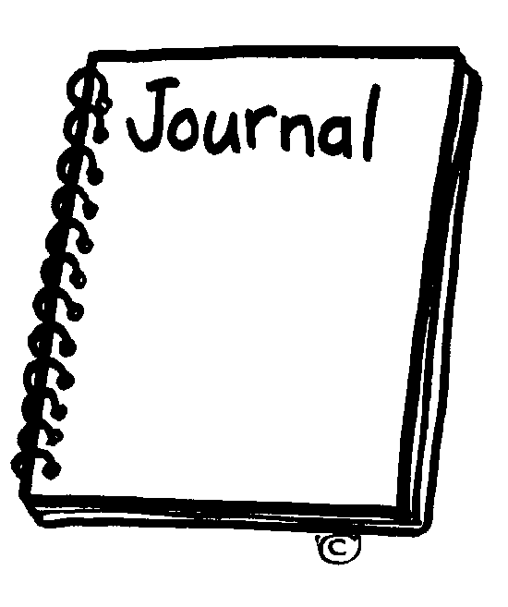
Learning Journal
Back to AFL Tools
Create a learning journal in which
students can reflect on and review
their learning. It could include plenary
activities, a target setting chart, aims
and goals etc.

Slide 28
Redrafting
Back to AFL Tools
Use lesson time to redraft work.
This allows students time to focus on
the feedback for improvement they
have been given.
It also reinforces the value of the
feedback and allows them to work
at it in a supportive environment.

Slide 29
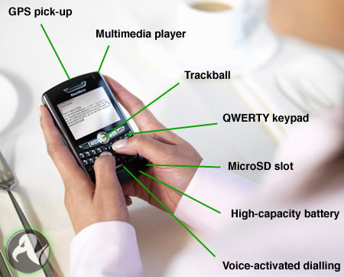
Key features
Back to AFL Tools
When designing written tasks to go
alongside oral work, intend for them
to develop and show understanding
of the key features of what students
have learned.

Slide 30
Improvement Guidance
Back to AFL Tools
When making comments on pupils’
work, treat them like guidance
showing how the pupil can improve.
Develop this by asking students to
write in the same way when peer
assessing work.
Discuss the notion of guidance and
how it differs from other types of
behaviour (i.e. prescription,
admonishment etc.)

Slide 31
Comment Follow-up
Back to AFL Tools
Give students opportunities to follow
up comments -
Create time in the lesson to talk to individual students.
Have a written dialogue in the students’ book.
Use a comment tracker or targets sheet to formalise the dialogue in a workbook

Slide 32
Group feedback
Back to AFL Tools
Group feedback to a teacher
concerning peer-assessment of work
can help make the teacher aware of
learning needs in a manageable way.
If a group feeds back then it draws
more attention and presents
information that has already been
ordered and sorted (meaning less
repetition for the teacher).

Slide 33
Peer Marking
Back to AFL Tools
Students mark each others’ work
according to assessment criteria.
Encourages reflection and thought about
the learning as well as allowing students
to see model work and reason past
misconceptions.
Opportunities to do this throughout
individual lessons and schemes of
work.

Slide 34
Thumbs
Back to AFL Tools
Check class understanding of what
you are teaching by asking them
to show their thumbs.
Thumbs up = I get it
Thumbs half way = sort of
Thumbs down = I don’t get it

Slide 35
Teach Collaboration
Back to AFL Tools
Peer assessment requires students to
act collaboratively. Indeed, AfL is a
collaborative enterprise. Therefore,
explicitly teach skills of collaboration.
This process can be assisted by
discussing collaboration with pupils
and making it visible as a part of the
classroom.

Slide 36
Traffic-Light Revision
Back to AFL Tools
When revising a topic or subject, work
through the different areas with
students and ask them to traffic light
according to their grasp of each.
Subsequently, students should be
able to target their revision more
carefully and engage in it actively,
rather than simply reviewing
everything they have done or reading
passively over their entire notes.

Slide 37
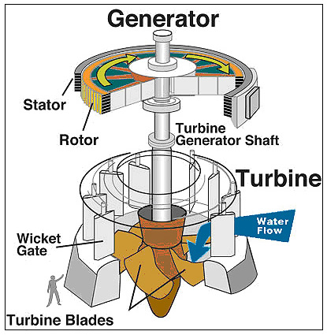
Generate and Answer
Back to AFL Tools
When preparing for exams, students
generate their own questions and
then practice answering them.
This makes learners think explicitly
about the underlying structures of
assessment, as well as the material
which they are being asked to
manipulate. Form as well as function!

Slide 38
Student Mark-Scheme
Back to AFL Tools
Ask students to produce their own
mark-schemes working individually or
in groups. They can then peer- or
self-assess work in accordance
with these schemes.
Talk about the purpose of a mark-
scheme with students – judgement,
communication, standardisation etc.

Slide 39
Group Answers
Back to AFL Tools
Students work in small groups to
agree on answers – when tests are
returned or in other situations.
The process of agreeing should
include reasoning over the validity of
the consensus answer, as well as
reasoned negation of misconceptions
or wrong answers.

Slide 40
Think through Talking
Back to AFL Tools
Talking allows students to articulate
their thoughts and thus to learn.
Encourage thinking through talking
with –
Discussion activities
Structured group/pair work
Modelling by teacher and students
(small group work increases the
‘surface area’ of talk in the classroom
as opposed to whole class
discussions)

Slide 41
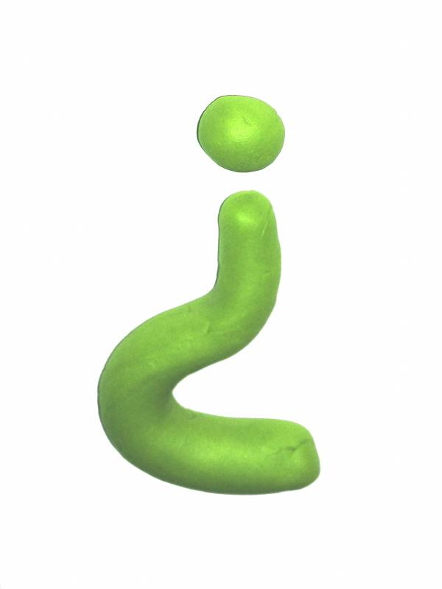
Invert the Question
Back to AFL Tools
Instead of asking a question that
requires factual recall, invert it to
request explicit reasoning.
e.g.
‘Is France a democracy?’
becomes
‘What does it mean for a country to be a democracy?’

Slide 42
X and Y
Back to AFL Tools
Ask students why X is an example of Y
e.g.
Why is an apple an example of a fruit?
Why is a fox an example of a mammal?
Questioning in this way avoids factual
recall and asks for the underlying
reasoning to be made explicit.

Slide 43
All you know
Back to AFL Tools
Students write down everything
they know about ________ at the
start of the unit.
The teacher can then teach the unit
accordingly, using existing
knowledge and avoiding repetition.

Slide 44
Corrections
Back to AFL Tools
Reinforce the focus on redrafting and
comment-only marking by insisting on
seeing evidence of student
corrections on their own work before
looking at it (have to allow time for
this).

Slide 45
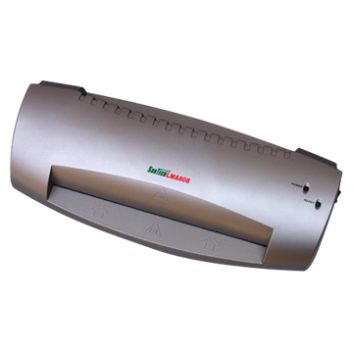
Laminated Criteria
Back to AFL Tools
Make laminated, student-
friendly assessment criteria
cards.

Slide 46
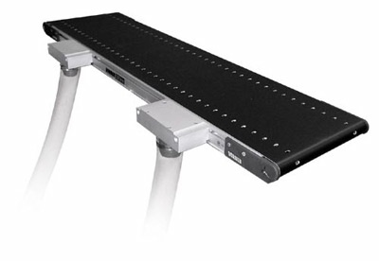
Conveying Progress
Back to AFL Tools
Find a means of using
assessment to convey progress to
students and thus make what they
are doing more meaningful.
Link learning between units
Use a learning journal
Refer to past targets and highlight where the student is achieving this
Have a target chart where it is visible how the student has progressed
Link assessment to student goal-setting
Progress

Slide 47
Discuss Words
Back to AFL Tools
When engaged in discussion take key
words and look at them specifically.
Discuss how they are being used –
Is there any ambiguity?
Is everyone using the word in the
same way?

Slide 48
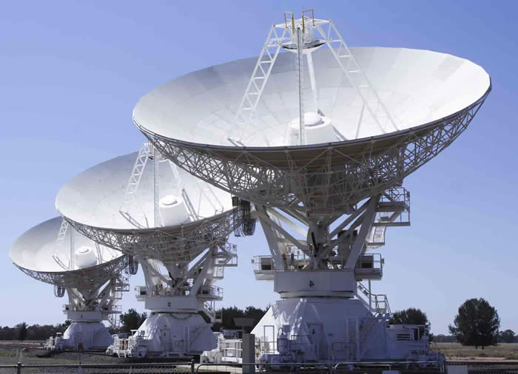
Communication
Back to AFL Tools
Ask students to communicate thinking
through different mediums – not just
writing; drawing, drama, maps,
sculpture etc.
The medium is the message and
therefore circumscribes to some
extent how communication can take
place. Using alternative mediums
allows the teacher to ‘see’ students’
understanding from different angles.

Slide 49
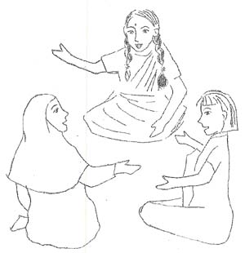
Thoughtful Dialogue
Back to AFL Tools
Dialogue between teacher and students
should be thoughtful, reflective,
focussed to evoke and explore
understanding, and conducted so that all
pupils have an opportunity to express
their ideas.
(Page 12, Inside the Black Box, Paul Black & Dylan William, nferNelson, 1998)
Discuss the quality of dialogue with
students and ask them to articulate what
its purpose is, why, and how (if
necessary) it may be improved).

Slide 50
Feedback Sandwich
Back to AFL Tools
Feedback can be delivered in
different ways, two feedback
‘sandwiches’ are –
Positive comment
Constructive criticism with explanation of how to improve
Positive comment
Contextual statement – I liked….because….
Now/Next time…
Interactive statement e.g. a question based on the work

Slide 51
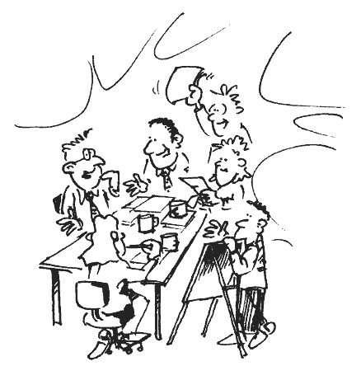
What is good?
Back to AFL Tools
Spend time ensuring that there is
consensus between yourself and the
pupils over what makes a piece of
work ‘good’, and how they are
expected to achieve it. Use questions
such as –
‘Can you tell me what makes a piece
of work good?’
‘How do you feel about comments?’
‘Do you always know what you need to do
next/think about?’
‘Do you know when you have done a
‘good’ piece of work?’

Slide 52
Self-evaluation
Back to AFL Tools
Self-evaluation involves learning how we
learn, whereas self-assessment is
what we learn. To train pupils in self-
evaluation, use questions such as:
Think about what has happened when the
learning has taken place
What really made you think? What did you
find difficult?
What do you need more help with?
What are you pleased about?
What have you learnt new about X?
How would you change the learning
activity to suit another class?
The teacher can model answers to these
to show the pupils how to self-evaluate.

Slide 53
What is a ‘good’ question?
Back to AFL Tools
Discuss with students what makes a
‘good’ question. The process can
explicitly show them the difference
between open and closed questions.
They can then come up with
questions on a topic and decide
which are best, and then move on
to discuss and answer these.

Slide 54
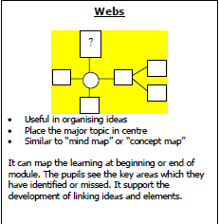
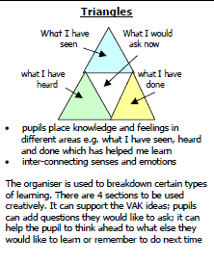
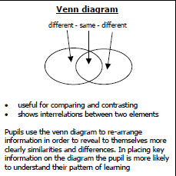
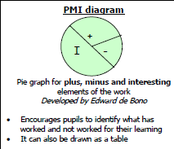
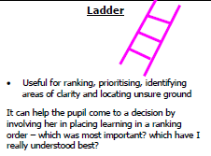
Graphic Organisers
Back to AFL Tools
Use graphic organisers to help pupils self-assess.
All these are taken from http://www.aaia.org.uk/pdf/Publications/AAIAformat4.pdf
(page 19)

Slide 55
KWL
Back to AFL Tools
At the beginning of a topic pupils create a
grid with three columns –
What They Know;
What They Want To Know;
What They Have Learnt.
They begin by brainstorming and filling in
the first two columns and then return to
the third at the end of the unit (or refer
throughout) .
Variation – extra column ‘How Will I Learn’

Slide 56
Talk Partners
Back to AFL Tools
As a plenary or a starter referring to
the last lesson, pupils share with a
partner:
3 new things they have learnt
What they found easy
What they found difficult
Something they would like to learn in the future

Slide 57
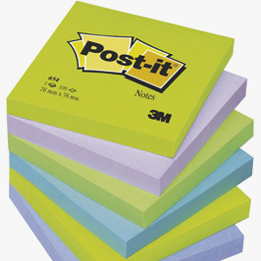
Post-It
Back to AFL Tools
Use post-it notes to evaluate learning.
Groups, pairs or individuals can
answer:
What have I learnt?
What have I found easy?
What have I found difficult?
What do I want to know now?

Slide 58
Response Partners
Back to AFL Tools
Paired or partnership oral marking.
Pupils invite a partner or a group to
discuss or comment on their work.
For it to be effective, students should
be aware of learning objectives and
success criteria. They should also
appreciate the role of a response
partner – to offer positive and
constructive feedback around the
learning goals.
Students could be given prompt
questions to ask the person who has
done the work.

Slide 59
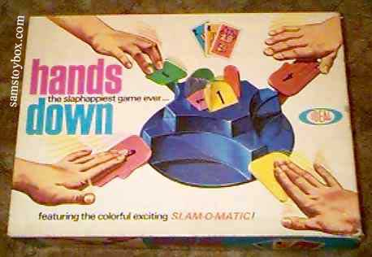
Hands Down
Back to AFL Tools
Tell pupils they should only raise their
hand to ask a question, not to answer one.
The teacher then chooses pupils to
answer, therefore gaining information on
whether everyone is learning.
www.classtools.net – fruit machine
programme on here where you can input
names, save it and play it to choose pupils
at random.
Write names on lollipop sticks and pull out
at random to answer.
Write numbers on balls or counters that
tally to register or seating position and re-
use with every class.

Slide 60
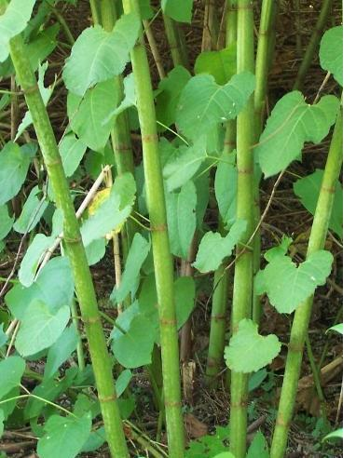
Good Question Stems
Back to AFL Tools
Why does…?
What if…?
How would you…?
Could you explain…?
What might…?

Slide 61
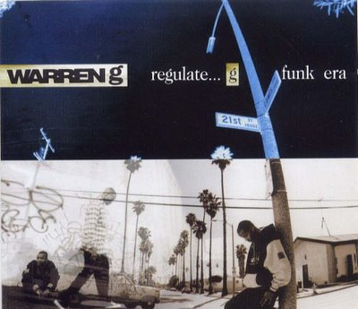
Regulating Learning
Back to AFL Tools
Circulating through the room whilst
students are engaged in an activity
means the teacher can collect
information on learning, employ
different assessment strategies and
intervene where appropriate.

Slide 62
A B C D
Back to AFL Tools
Laminate a set of cards so every
member of the class has four, with
A,B,C and D written on them. Ask
questions with four answers and
pupils can show you their answer.
Encourage them not to look at other
people’s response so as to copy.

Slide 63
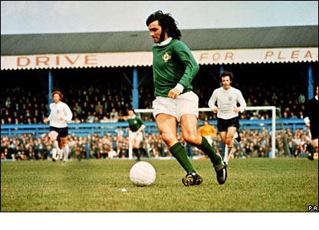
Why is it best?
Back to AFL Tools
For homework ask students to find
their best piece of work and then to
tell you why it is their best. This
explanation could refer to success
criteria, levels, targets etc.

Slide 64
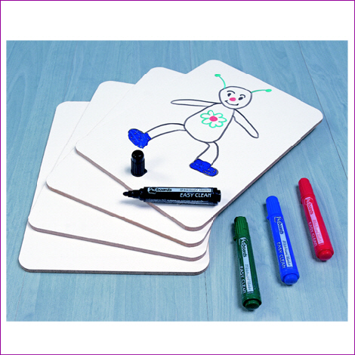
Show and Tell
Back to AFL Tools
Use mini-whiteboards so that very
student can write or draw their
answer and show it to you (or their
peers) immediately.

Slide 65
Active Students
Back to AFL Tools
Key to AfL is students being active,
engaged participants in their learning.
Think of ways in which content can be
manipulated for these ends, rather
than the other way round.
If the content seems boring then
make the approach fun or interesting.

Slide 66
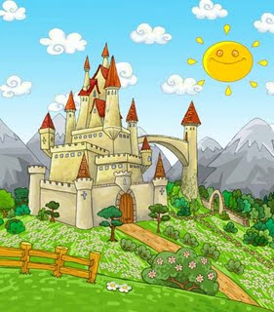
Long and Short Term
Back to AFL Tools
To draw together progression with the
big picture, students could set both
long and short term targets.
The short term targets could be
reviewed weekly or fortnightly and the
long term targets at the end of term.
Having a long term target may give
more cogency to the pupil’s and
teacher’s short term targets. It may
also allow the pupil to focus on what
Really motivates them about a
subject.

Slide 67
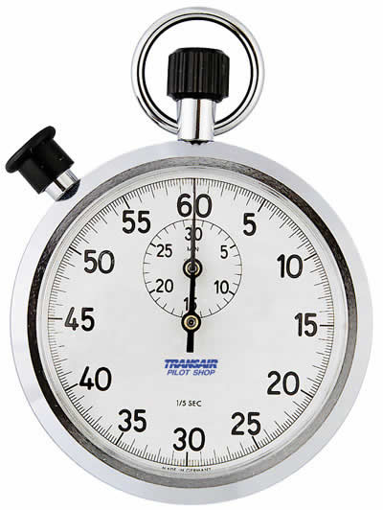
Minute Paper
Back to AFL Tools
Students identify the most significant
(useful, meaningful, unlikely) thing
they have learnt during the lesson or
unit.

Slide 68
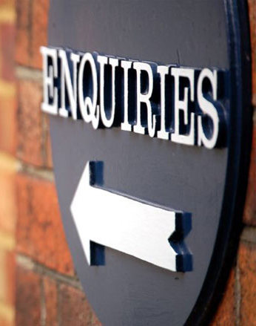
Enquiry Question
Back to AFL Tools
Use an enquiry question to stimulate
high-level thinking in the lesson or
unit.
e.g.
How democratic is the United Kingdom?
Why is our school so ethnically diverse?
What is enquiry-based learning -
http://www.campus.manchester.ac.uk/ceebl/ebl/

Slide 69
Smiley Faces
Back to AFL Tools
Students draw smiley faces to indicate how comfortable they are with the topic.
Ready to move on
Understand some parts but not all
Do not understand and need to look at it again

Slide 70
Squares
Back to AFL Tools
When a pupil has finished a piece of
work they draw a square on the page.
If they do not understand the work
they colour it red, if they are so-so
then yellow and if A-OK the green.

Slide 71
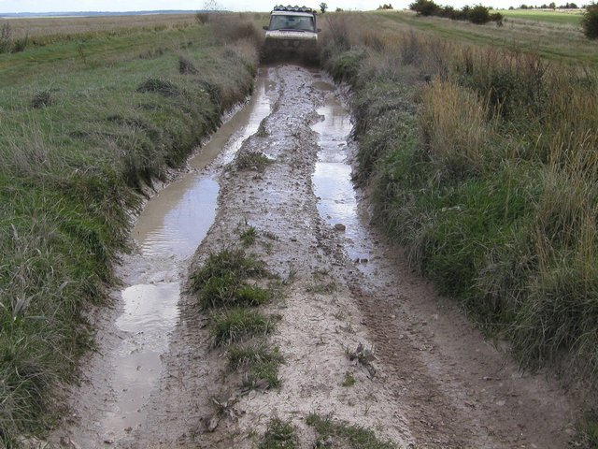
Muddiest Point
Back to AFL Tools
Students write down one or two
points on which they are least clear.
This could be from the previous
lesson, the rest of the unit, the
preceding activity etc. The teacher
and class can then seek to remedy
the muddiness.

Slide 72
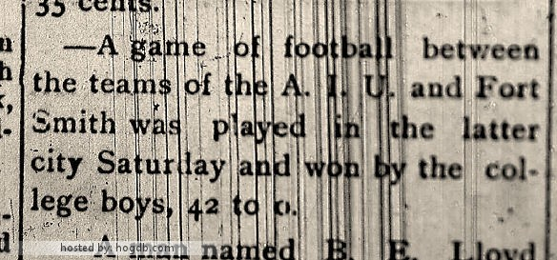
One-Sentence Summary
Back to AFL Tools
Students write a sentence
summarising their knowledge of a
topic.
The sentence could have to include
who, what when, why, how, where
etc.
The sentences could then be peer-
assessed, re-drafted and so on.

